Slide 1
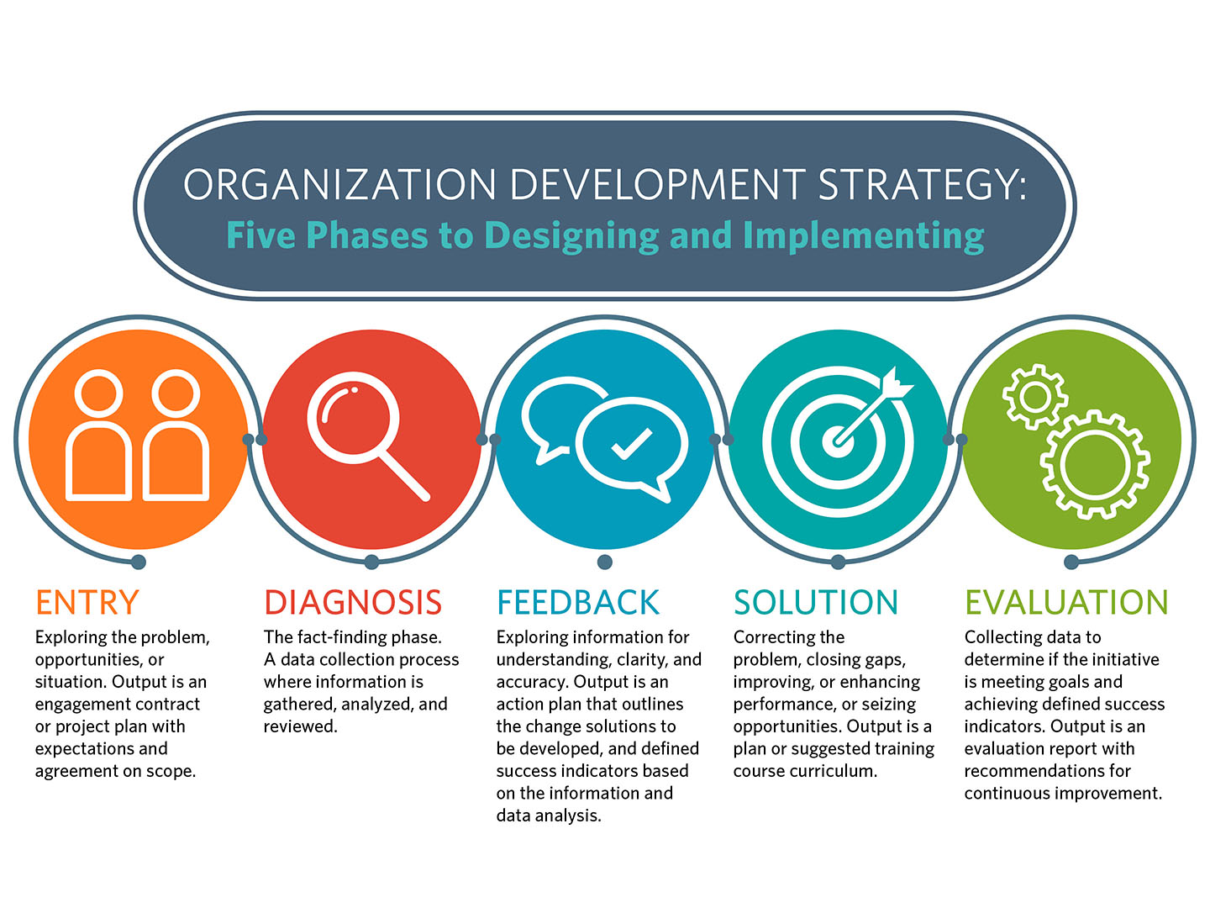
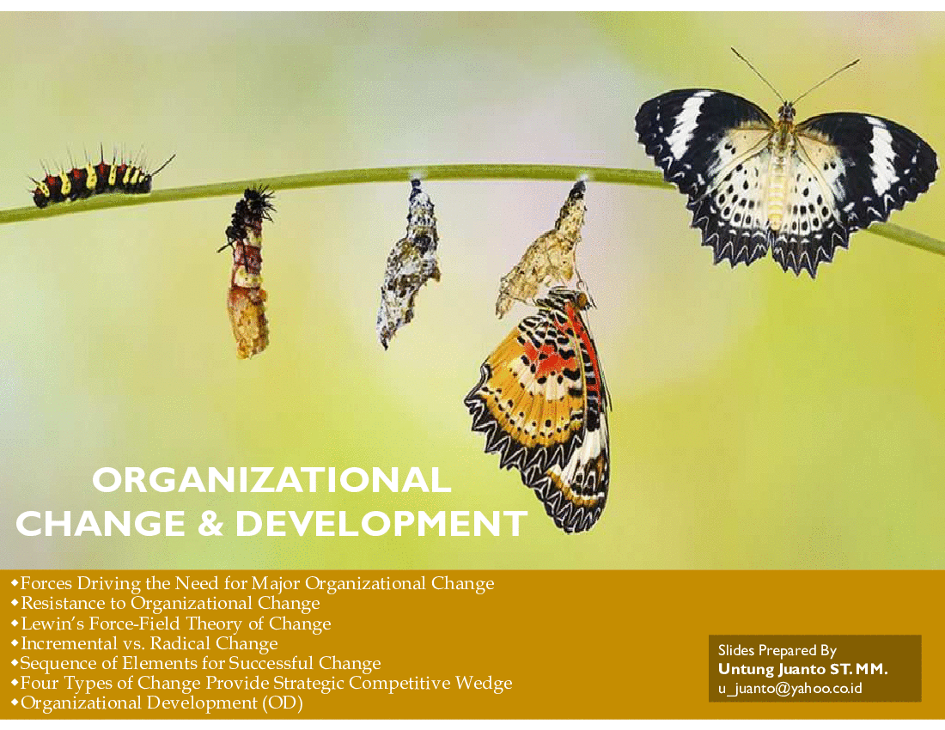
Organizational Change and Development

Slide 2
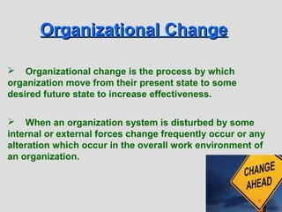

Slide 3
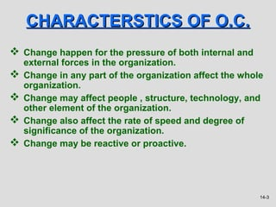

Slide 4
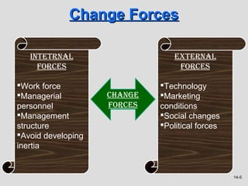
External Forces:
Market Changes: Shifts in the market, such as new competitors, changing customer preferences, or economic conditions, can force organizations to adapt their strategies and operations.
Technological Advances: Rapid technological advancements can create opportunities or threats, requiring organizations to embrace new technologies or modify existing ones to stay competitive.
Regulatory Changes: Alterations in laws and regulations can impact how organizations operate, prompting them to make changes to comply with new requirements.

Slide 5
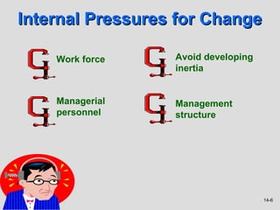
Internal Forces:
  Leadership Changes: Changes in leadership, whether at the executive or managerial level, can bring about new visions, strategies, and management styles, leading to organizational change.
  Organizational Growth or Decline: Rapid growth may necessitate structural changes to accommodate increased complexity, while decline may require restructuring for efficiency and survival.
  Performance Issues: If an organization faces declining performance, whether financial, operational, or in terms of employee satisfaction, there may be a need for changes to improve overall effectiveness.
  Crisis or Urgency: Unexpected events, crises, or urgent situations may require immediate organizational changes to address and overcome challenges.

Slide 6
Cultural Forces:
  Cultural Shifts: Changes in societal values, expectations, and attitudes can influence an organization's culture, requiring adjustments to align with evolving societal norms.
  Employee Expectations: As employee expectations change, organizations may need to adapt their policies, practices, and work environment to attract and retain talent.
Globalization:
  International Expansion: Organizations expanding globally may need to adjust their structures, communication processes, and strategies to operate effectively in different cultural and regulatory environments.
Innovation:
  Continuous Improvement: The pursuit of innovation and continuous improvement can drive organizational change as companies seek to stay ahead of the competition and enhance efficiency.

Slide 7

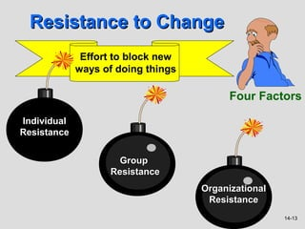
Resistance to change is an unwillingness to adopt new circumstances or ways of doing things.
Osho once said “The greatest courage is being capable of change.”

Slide 8
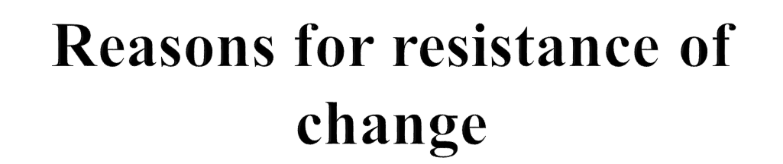
Lack of trust
One of the reasons for resistance of change is lack of trust in the leadership team or the company as a whole.

Slide 9
Reasons for resistance of change
2. Poor communication
lack of communication can greatly impact even the most well-thought-out and planned organizational change.

Slide 10
Reasons for resistance of change
3. Emotional response
Common emotional response to change are fear , uncertainty, and worry.

Slide 11
Reasons for resistance of change
4.Fear of failure
Change can bring about a fear that it will be unsuccessful or that the individuals involved will personally fail as a result of the changes that were made.

Slide 12
Tips to minimize resistance of change
Communicate early and after
Listen to employees
Educate employees on the value of change
Provide ongoing support

Slide 13
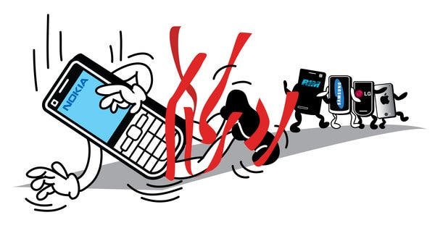

Continuous Change at Nokia and Stop adopting changing
Nokia has continually adapted to its changing environment. The Finnish company began as a pulp and paper mill in 1865, then moved
into rubber, cable wiring, and computer monitors. In the 1980s, Nokia executives sensed an emerging market for wireless communication. Around 2006, Nokia was a world leader in cellular telephones. But when it ignored the change in the world once again it failed.

Slide 14
Changing People: Some Basic Steps
Incorporating the changes,
creating and maintaining a
new organizational system
Step 3: Refreezing
Attempting to
create a new state
of affairs
Step 2: Changing
Current State New State
Recognizing the
need for change
Step 1: Unfreezing

Slide 15
Sensitivity
groups
Objective
data
Group members
recognize problem
Diagnose group’s
strengths and
weaknesses
Team Building:
Its Basic Steps
Develop desired
change goals
Restart process
Develop action plan
to make changes
Implement plan
Evaluate plan
if unsuccessful
if successful
Process
completed

Slide 16

Some External Forces for Change
Information
Technology
Globalization
& Competition
Demography

Slide 17
Force Field Analysis
Restraining
Forces
Desired
Conditions
Restraining
Forces
Driving
Forces
Restraining
Forces
Driving
Forces
Current
Conditions
Driving
Forces
Before
Change
During
Change
After
Change

Slide 18
Resistance to Change
Direct Costs
Saving Face
Fear of the Unknown
Breaking Routines
Incongruent Systems
Incongruent Team Dynamics
Forces for
Change

Slide 19
Creating an Urgency for Change
Need to motivate employees to change
Most difficult when organisation is doing well
Must be real, not contrived
Customer-driven change
  Adverse consequences for firm
  Human element energizes employees

Slide 20
Minimizing Resistance to Change
Communication
Minimizing
Resistance
to Change
Coercion
Training
Negotiation
Employee
Involvement
Stress
Management

Slide 21
Refreezing the Desired Conditions
Creating organizational systems and team dynamics to reinforce desired changes
  alter rewards to reinforce new behaviours
  new information systems guide new behaviours
  recalibrate and introduce feedback systems to focus on new priorities

Slide 22

Change Agents
Anyone who possesses enough knowledge and power to guide and facilitate the change effort
Change agents apply transformational leadership
  Help develop a vision
  Communicate the vision
  Act consistently with the vision
  Build commitment to the vision
Courtesy of CHC Helicopter Corp.

Slide 23
Successfully Diffusing Change
Successful pilot study
Favourable publicity
Top management support
Labour union involvement
Diffusion strategy described well
Pilot program people moved around
Courtesy of CHC Helicopter Corp.

Slide 24
Organization Development Defined
A planned system wide effort, managed from the top with the assistance of a change agent, that uses behavioural science knowledge to improve organizational effectiveness.

Slide 25
Organizational Development: How Effective Is It?
Organizational outcomes
more often benefited from
OD interventions than did
individual outcomes
50
(48.70)
40
30
(23.55)
Percentage of Studies Showing Positive Changes
20
Individual
outcomes
(e.g., job
satisfaction)
Organizational
outcomes
(e.g., profit)
(Source: Porras and Robertson, 1992.)

Slide 26
Action Research Process
Establish
Client-
Consultant
Relations
Diagnose
Need for
Change
Introduce
Change
Evaluate/
Stabilize
Change
Disengage
Consultant’s
Services

Slide 27
Appreciative Inquiry Process
Discovery
Dreaming
Designing
Delivering
Discovering the best of “what is”
Forming ideas about “what might be”
Engaging in dialogue about “what should be”
Developing objectives about “what will be”

Slide 28
Organization Development Concerns
Cross-Cultural Concerns
  Linear and open conflict assumptions different from values in some cultures
Ethical Concerns
  Management power
  Employee privacy rights
  Employee self-esteem
  Consultant’s role

Slide 29
The Ethics of OD:
Summary of the Debate
OD is
ethical
The imposition of values
is an inherent part of life,
especially on the job
Abuse comes from
individuals, not from
the technique itself,
which is neither good
nor evil
OD is
unethical
Imposes values of the
organization; coercive
and manipulative
Potential for abuse

